Slide 1
AI-Powered EDA Tools: Current Trends and Future Directions
Presented by: Abu Sayem – 2210031
Instructor: Prof. Dr. –Ing. Ali Hayek
Course: Advanced Hardware Engineering

Slide 2
Agenda
Traditional EDA to AI-Native Flow
AI for Digital Physical Design
Graph Neural Networks & Open Datasets
Verification & High-Level Design with LLMs
Analog & Mixed-Signal Optimization
Commercial AI-Powered EDA Tools
Benefits, Challenges & Future Directions

Slide 3
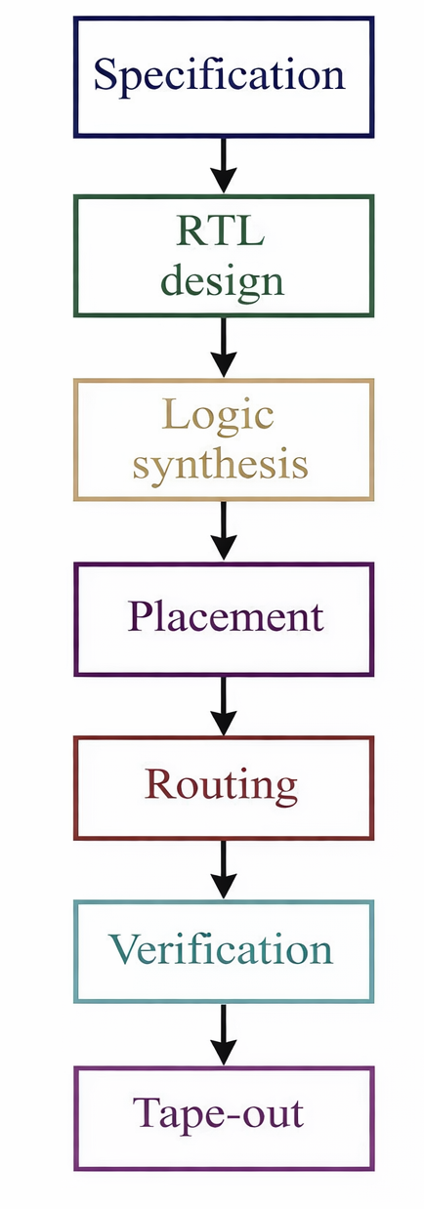
Classical RTL-to-GDSII Flow
From specification to fabrication-ready layout:
RTL Design – Register Transfer Level description (Verilog/VHDL)
Synthesis – Gate-level netlist generation.
Place & Route – Physical design optimization.
Verification – Functional and physical validation.

Slide 4
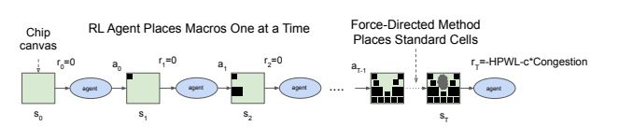
AI for Macro Placement
Reinforcement Learning optimizes cell placement for PPA:
RL agents learn placement strategies autonomously
Faster convergence than traditional heuristics
Reduces design turnaround time by 30–50%
Method inspired by Mirhoseini et al. [DeepMind's AlphaChip]

Slide 5
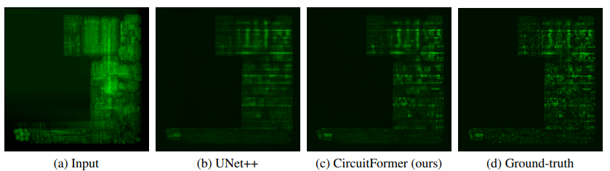
ML-Based Prediction Models
Fast, accurate estimation without full simulation:
Congestion Prediction – Identify bottlenecks early using ML models
Timing Closure – Gradient-boosted trees & neural networks for delay prediction
Power Prediction – ML-based IR-drop and power estimation from partial implementation

Slide 6
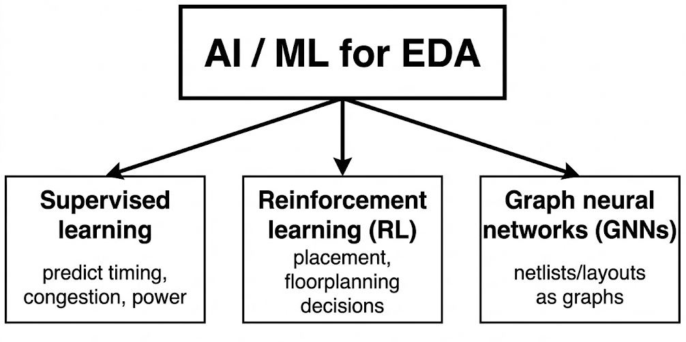
Graph Neural Networks (GNNs)
Leveraging circuit topology for learning:
Netlists and layouts as graph structures (nodes = cells/macros, edges = nets/connections)
Open datasets enable research: CircuitNet, ISPD, Bookshelf
GNNs capture design structure effectively & generalize across designs
CircuitNet : thousands of designs with routability, IR-drop, timing labels

Slide 7
Functional Verification & LLMs
Large Language Models for testbench generation & RTL code synthesis
Natural language specifications to RTL (VerilogEval benchmarks)
ML-based test prioritization reduces simulation cycles needed
LLM debugging assistance & automatic verification property generation

Slide 8
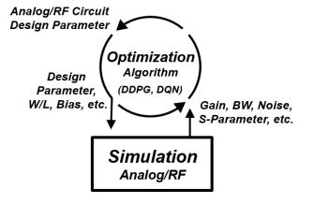
Analog & Mixed-Signal Optimization
ML surrogate models for performance prediction (neural networks, Gaussian processes)
Evolutionary algorithms + Bayesian optimization for device sizing
Reduce SPICE simulation iterations significantly
Applications: amplifiers, comparators, voltage references, RF front-ends

Slide 9

Commercial AI-Powered EDA Tools
DSO.ai, VSO.ai, TSO.ai
AI-driven design space exploration & physical design optimization
Advanced-node design support

Slide 10

Commercial AI-Powered EDA Tools
Cerebrus Intelligent Chip Explorer
Intelligent P&R optimization for large digital blocks
Tunes place-and-route flow parameters

Slide 11

Commercial AI-Powered EDA Tools
Solido ML Tools
Variation-aware analog/RF design
Reduces Monte Carlo simulations for characterization

Slide 12

Commercial AI-Powered EDA Tools
AI-Assisted Design Flows
GPU & tensor block optimization
Internal accelerator chip design

Slide 13
Key Benefits of AI-Powered EDA
Design Turnaround Time – 30–50% reduction (days to hours for placement)
PPA Improvement – Power, Performance, Area optimization (2–5% gains)
Automation – Reduce manual tuning and iterations
Scalability – Handle advanced nodes (3nm, 1.4nm, …) with increasing design complexity

Slide 14
Open Challenges & Future Directions
Data Availability – Real industrial designs confidential; limited public datasets
Generalization – Models struggle across different technologies/nodes
Interpretability – Black-box AI decisions hard to trust in critical design
Integration – Seamless EDA tool ecosystem adoption; need human-in-the-loop verification

Slide 15
Conclusion
AI and machine learning are transforming chip design from manual art into automated science. While challenges remain in data availability and model generalization, commercial adoption by major EDA vendors proves real-world impact. The future belongs to engineers who master both classical EDA algorithms and modern AI/ML techniques.

Slide 16

Questions?
Do not ask

